Slide 1
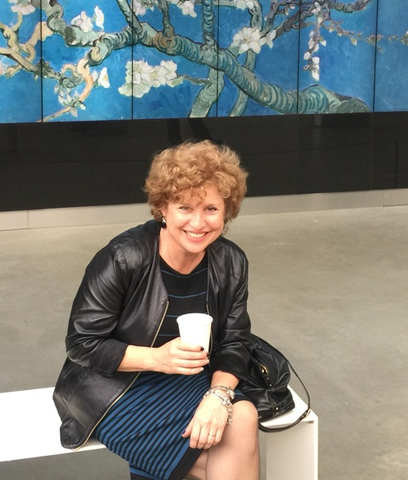
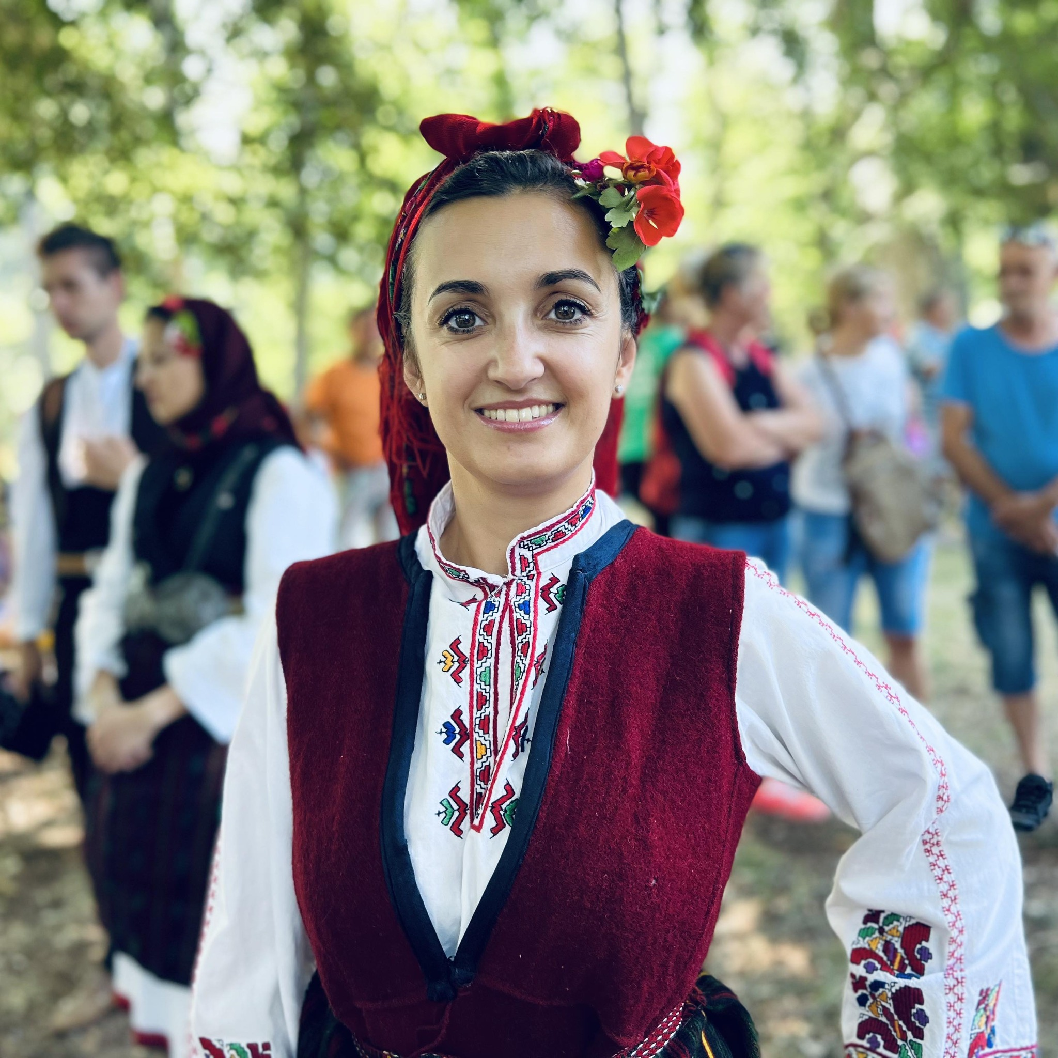
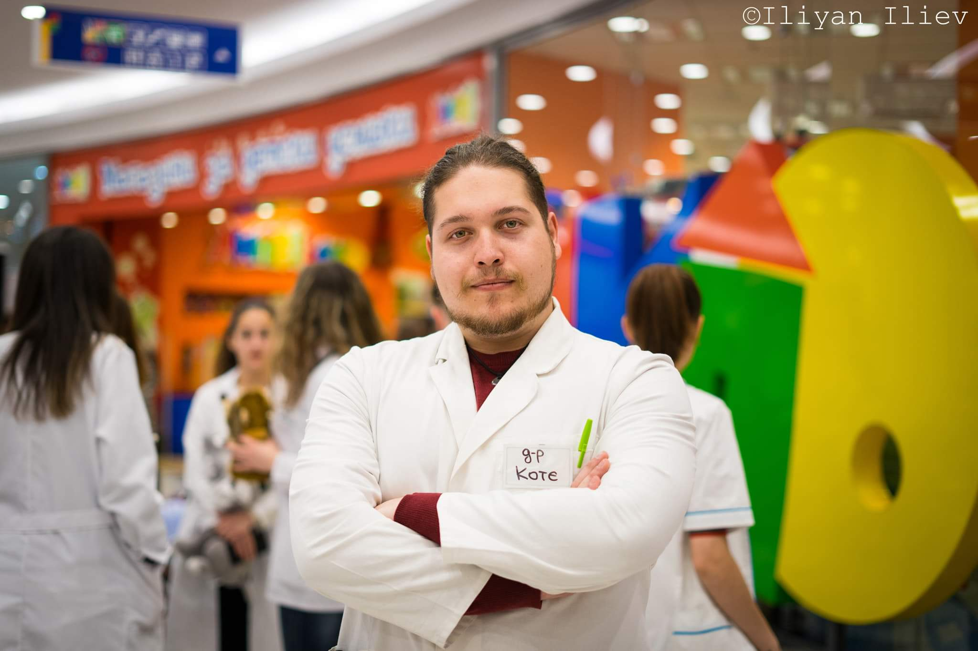
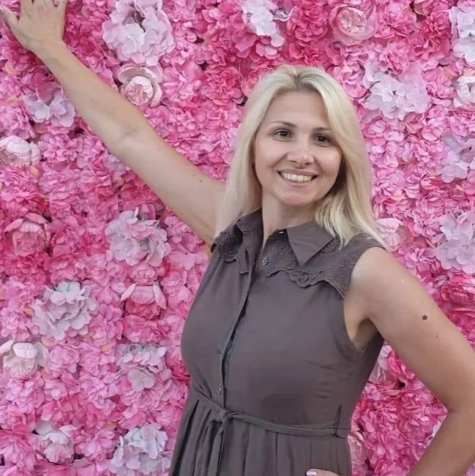
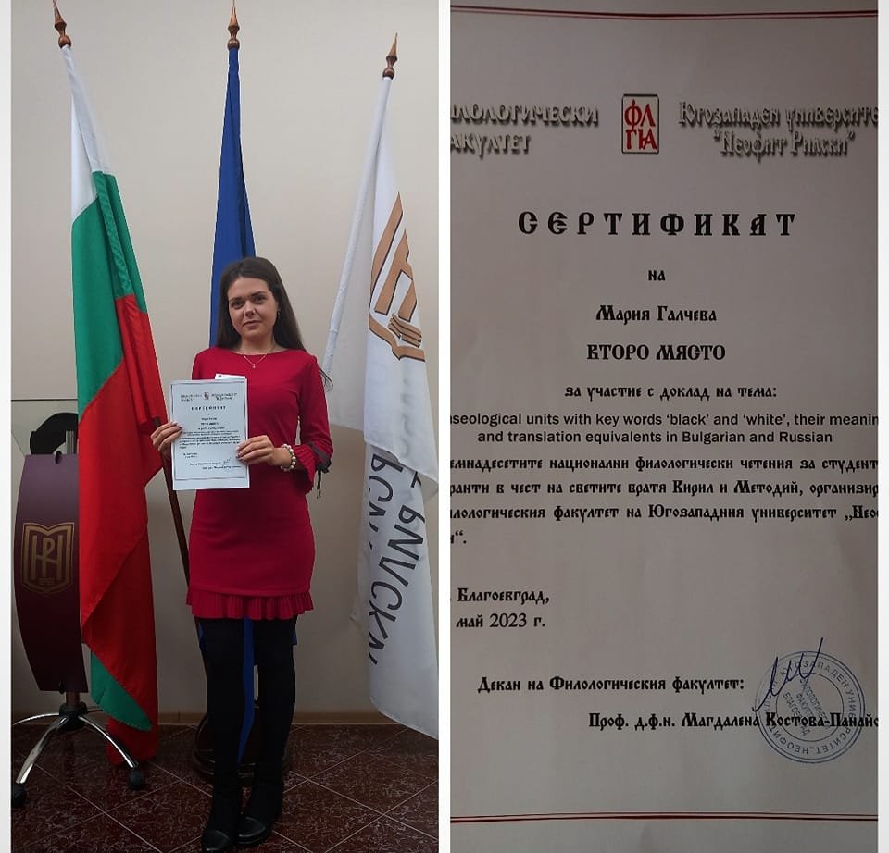
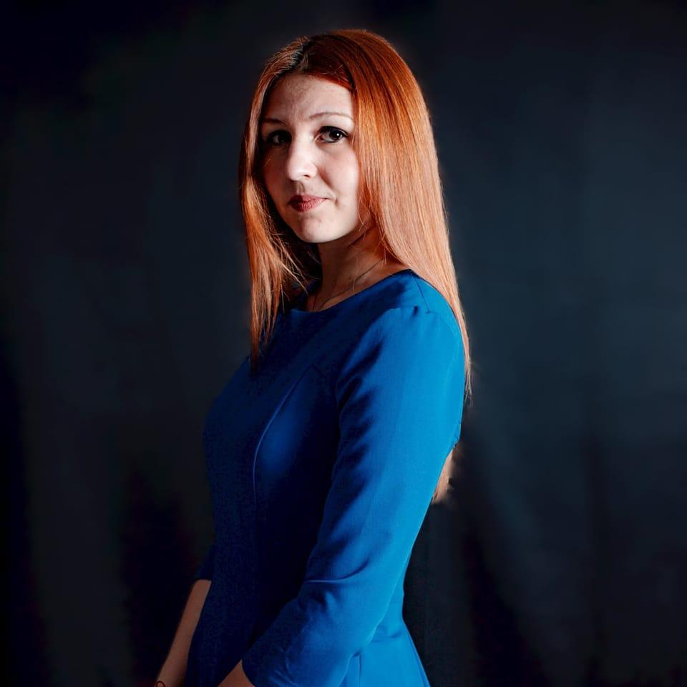
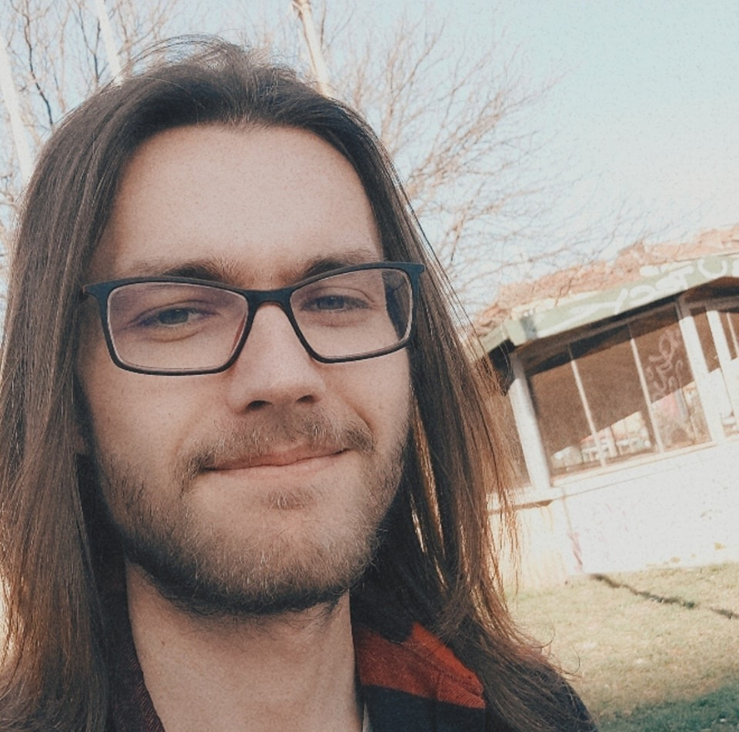
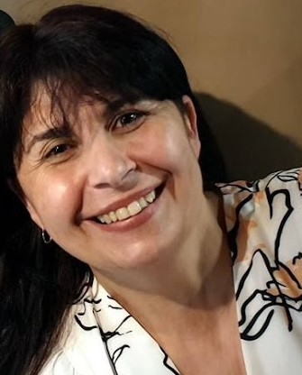
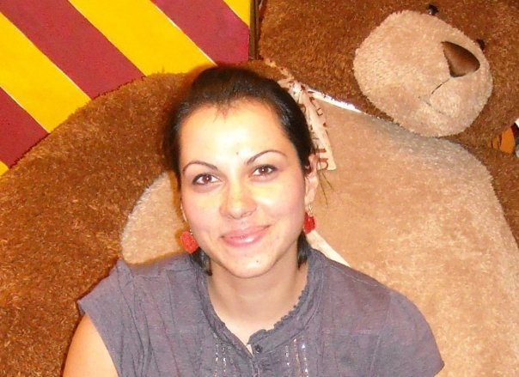
Our civil society organisation was established in 2020 as a result of long-lasting cooperation of its current members – Dr Elena Sayanova and her former students, who are successful people in different spheres of life. All of us firmly believe in this idea:
“Be the change you wish to see in the world” /Mahatma Gandhi/

Slide 2

RILA & PIRIN ENHANCEMENT INITIATIVE, NGO
Together, we
– contribute to the socio-economic development of the country in the fields of education, intellectual labour, tourism in all its forms by helping to raise funds and implementation of projects;
– actively participate in protecting the environment, cultural and historical heritage as well as sustainable development;
– collaborate with other non – profit organizations to increase the capacity of the civil sector in public life;
– organise activities aimed at the development and affirming that respect for the diversity of cultures, tolerance, dialogue and the vitality of civil society.

Slide 3
RILA & PIRIN ENHANCEMENT INITIATIVE, NGO
OUR MISSION
Be actively involved in numerous community initiatives, participate in fundraising committees, various local, national and international projects.
Help to raise funds and implement projects and play an active role in protecting the environment and the biological diversity, cultural and historical heritage and sustainable development.

Slide 4

RILA & PIRIN ENHANCEMENT INITIATIVE In various projects
Rila&Pirin Enhancement Initiative was an associated partner of the project
‘’Capitalizing on Local Intangible Cultural Heritage around Europe’’/ CLICHÉ
with partners from Greece, Slovenia, Cyprus, Estonia and Lithuania/2020

Slide 5

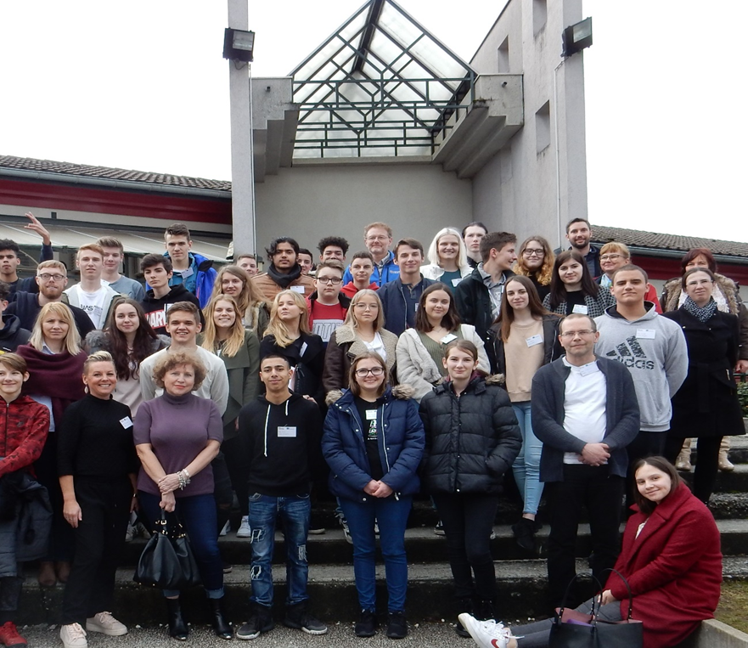
RILA & PIRIN ENHANCEMENT INITIATIVE
Rila&Pirin Enhancement Initiative
was an associated partner of
‘Fake News Among Teenagers –
Towards a More Responsible
Media Literacy’/2020

Slide 6
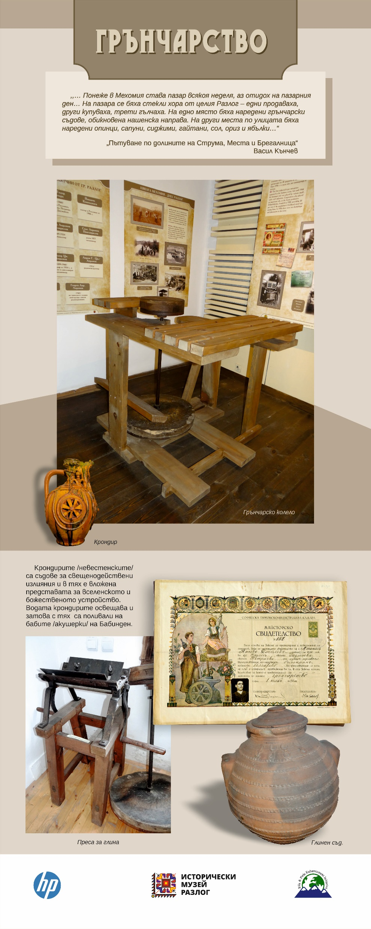
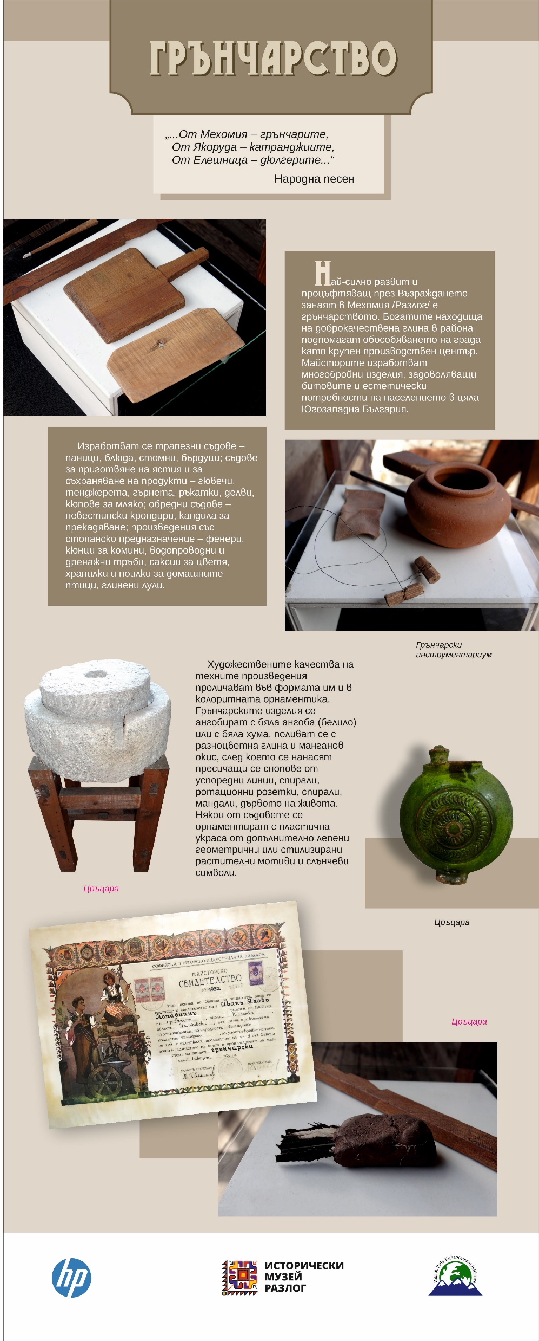

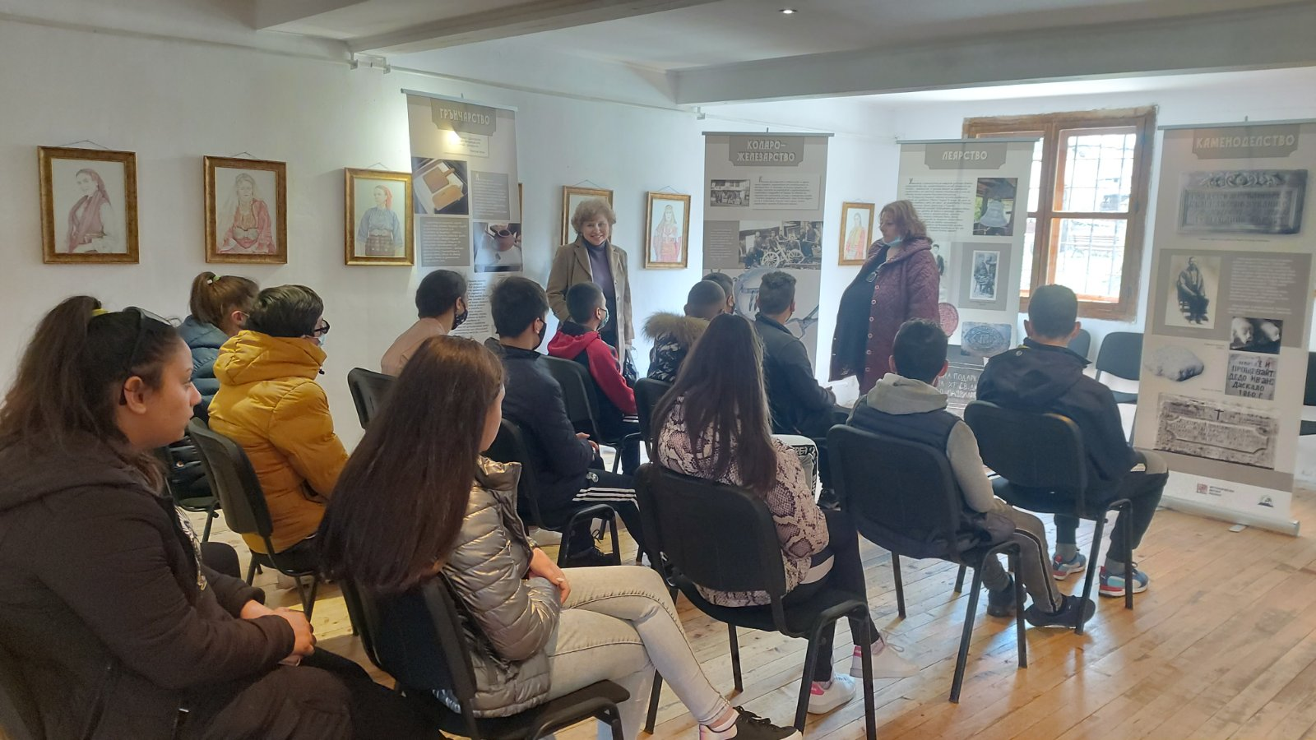
Rila-Pirin Enhancement Initiative raised and donated BGN 1,120.00 for the purpose of paying for designing and printing panels/ banners for a mobile museum exhibition dedicated to old crafts/2021.

Slide 7
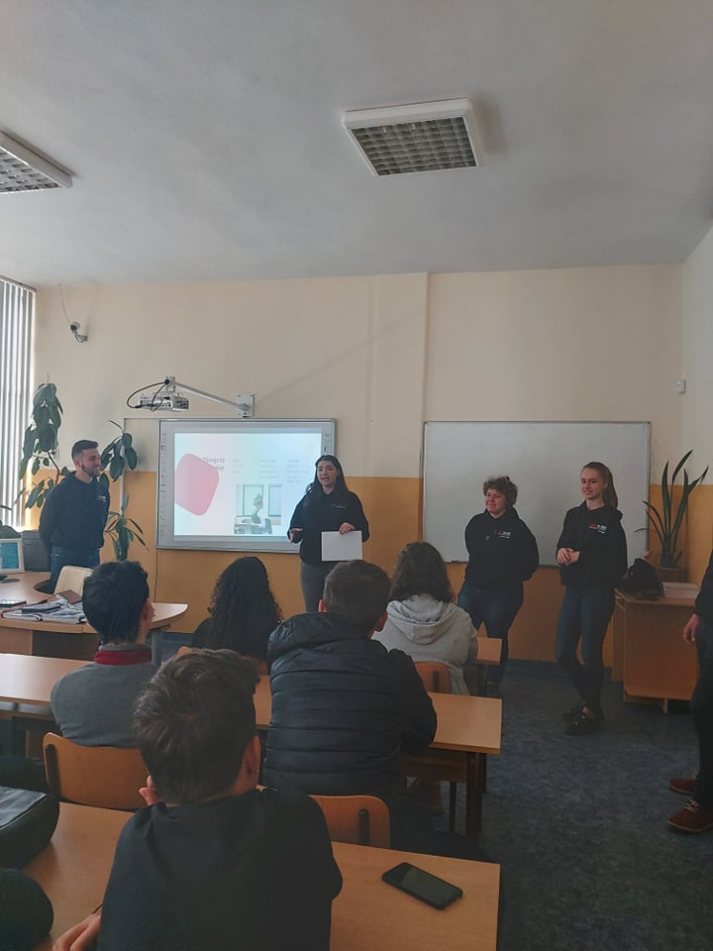
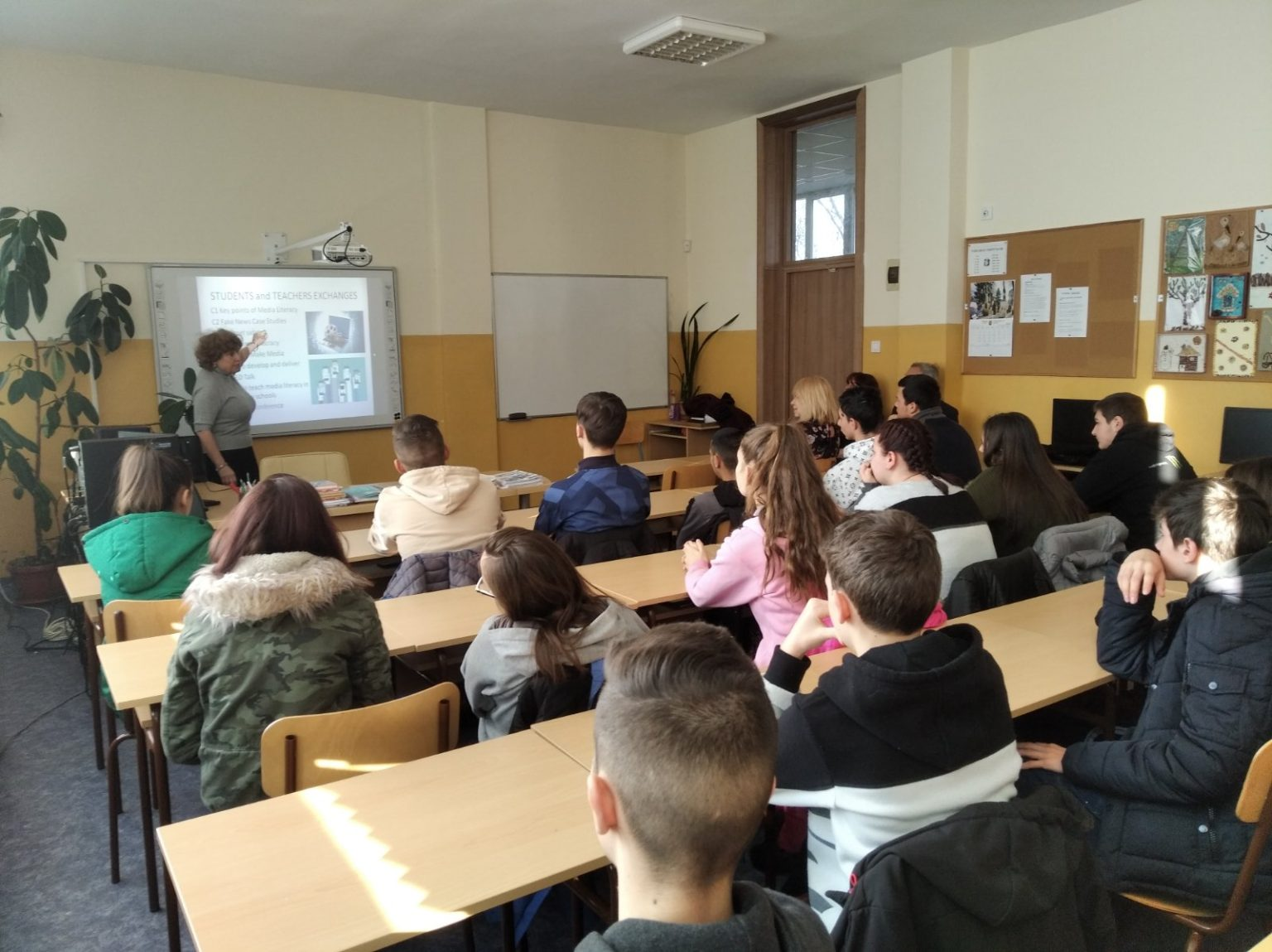
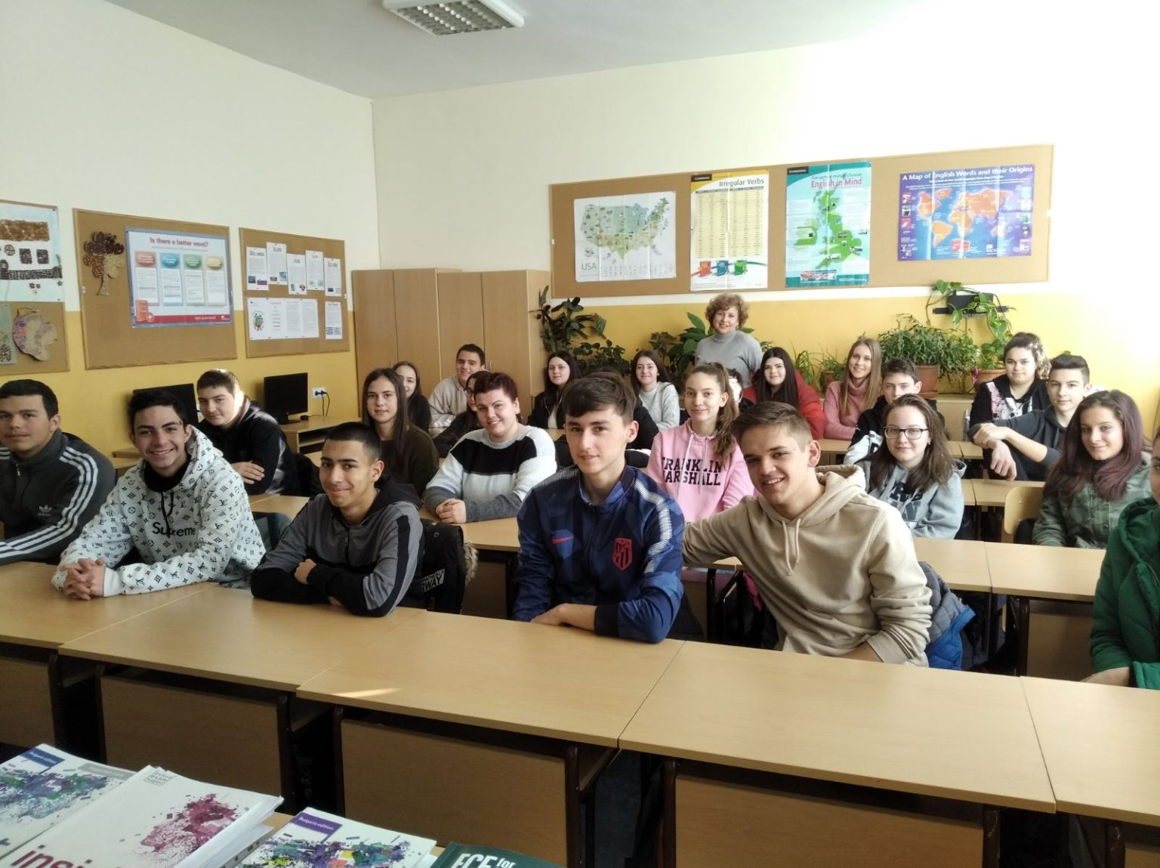
Rila-Pirin Enhancement Initiative representatives organized a series of workshops on Media Literacy for the local schools/2021-2022

Slide 8



Rila-Pirin Enhancement Initiative, is a partner in KA210-SCH – Small-scale partnerships in school education.
’Combatting Media&Information Illiteracy to Raise Good Citizens’
Partnership: Portugal, Italy, Bulgaria, Turkey

Slide 9


Rila-Pirin Enhancement Initiative, is a partner in KA210-SCH – Small-scale partnerships in vocational education
‘Up-skilling in Remote Working through Exploring the Relatively New Phenomenon of Co-working’
Partnership: Italy, Croatia, Bulgaria, Turkey

Slide 10
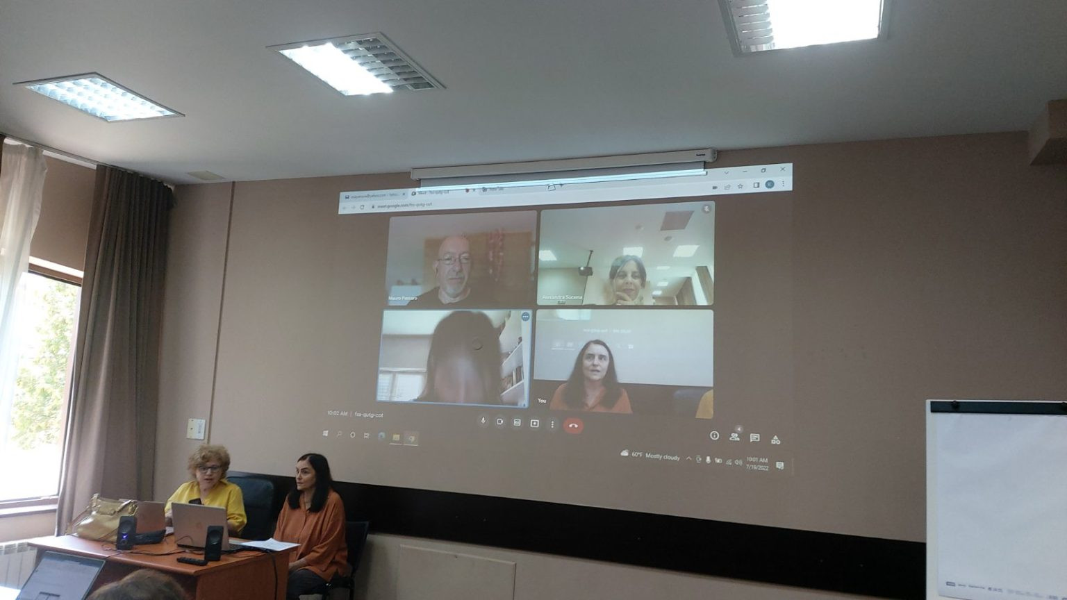
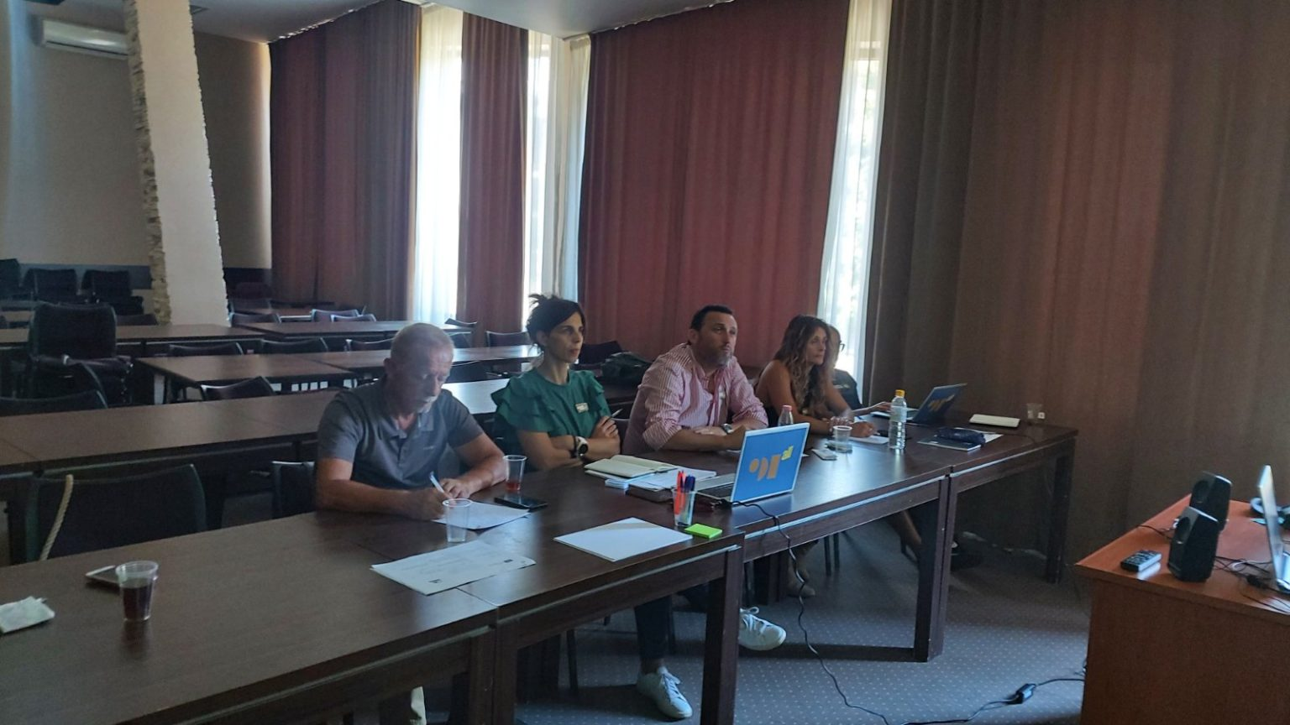
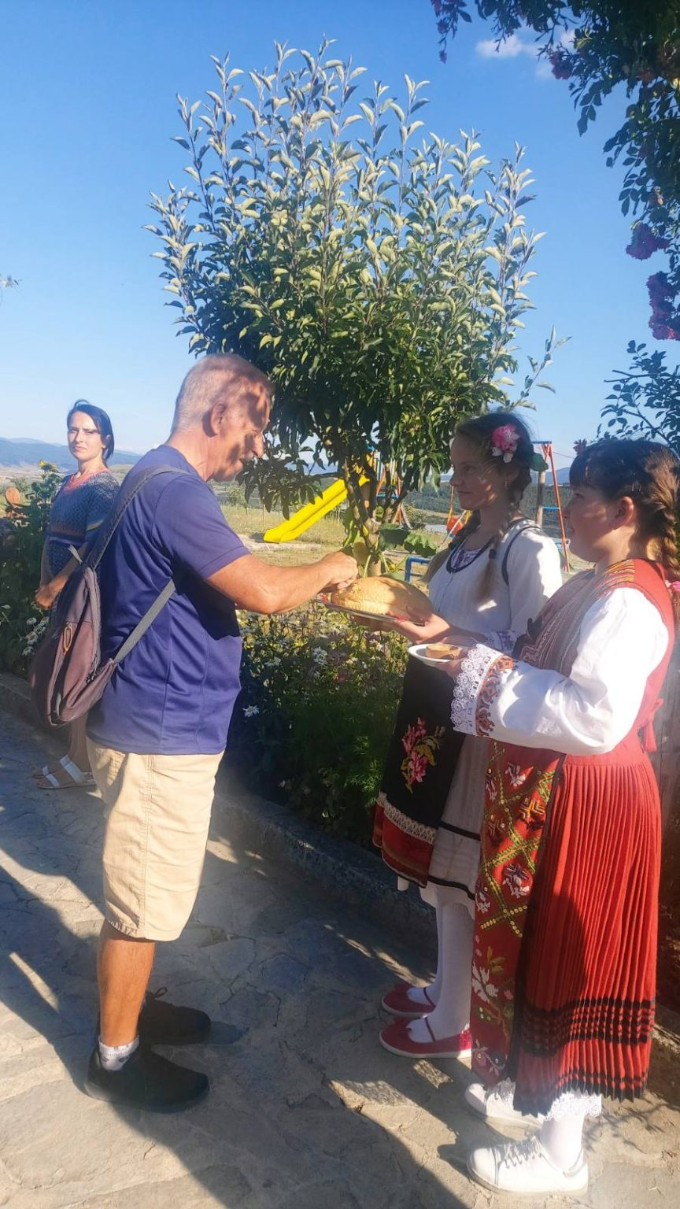
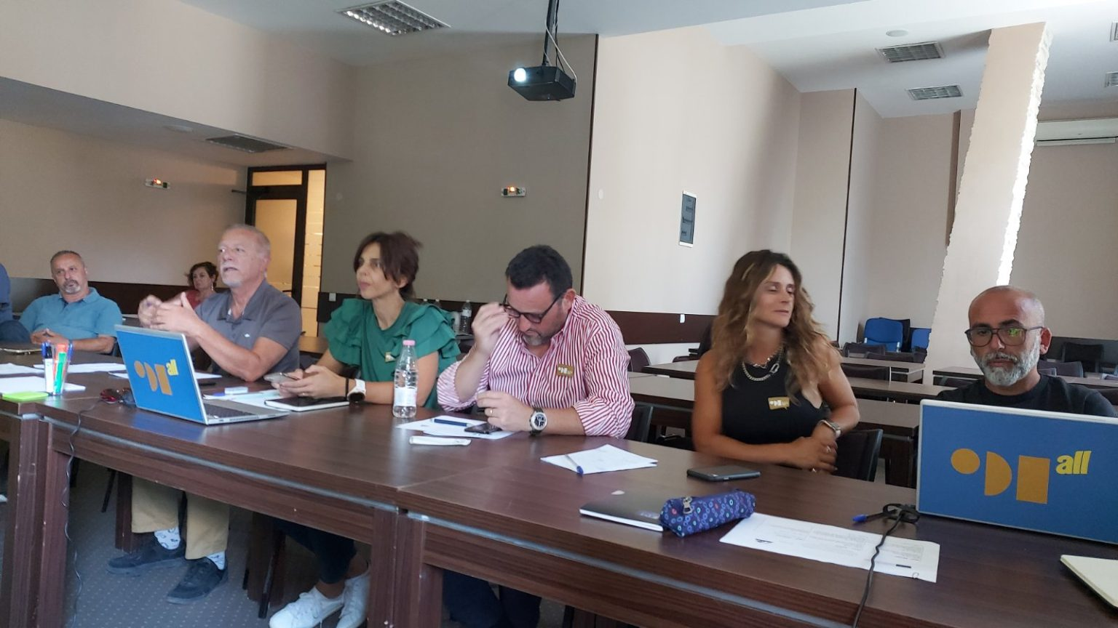
TRANSNATIONAL PROJECT MEETING
KA210-SCH – Small-scale partnerships in school education and training
’Combatting Media&Information Illiteracy to Raise Good Citizens’
Bulgaria, 17th– 21st July, 2022

Slide 11
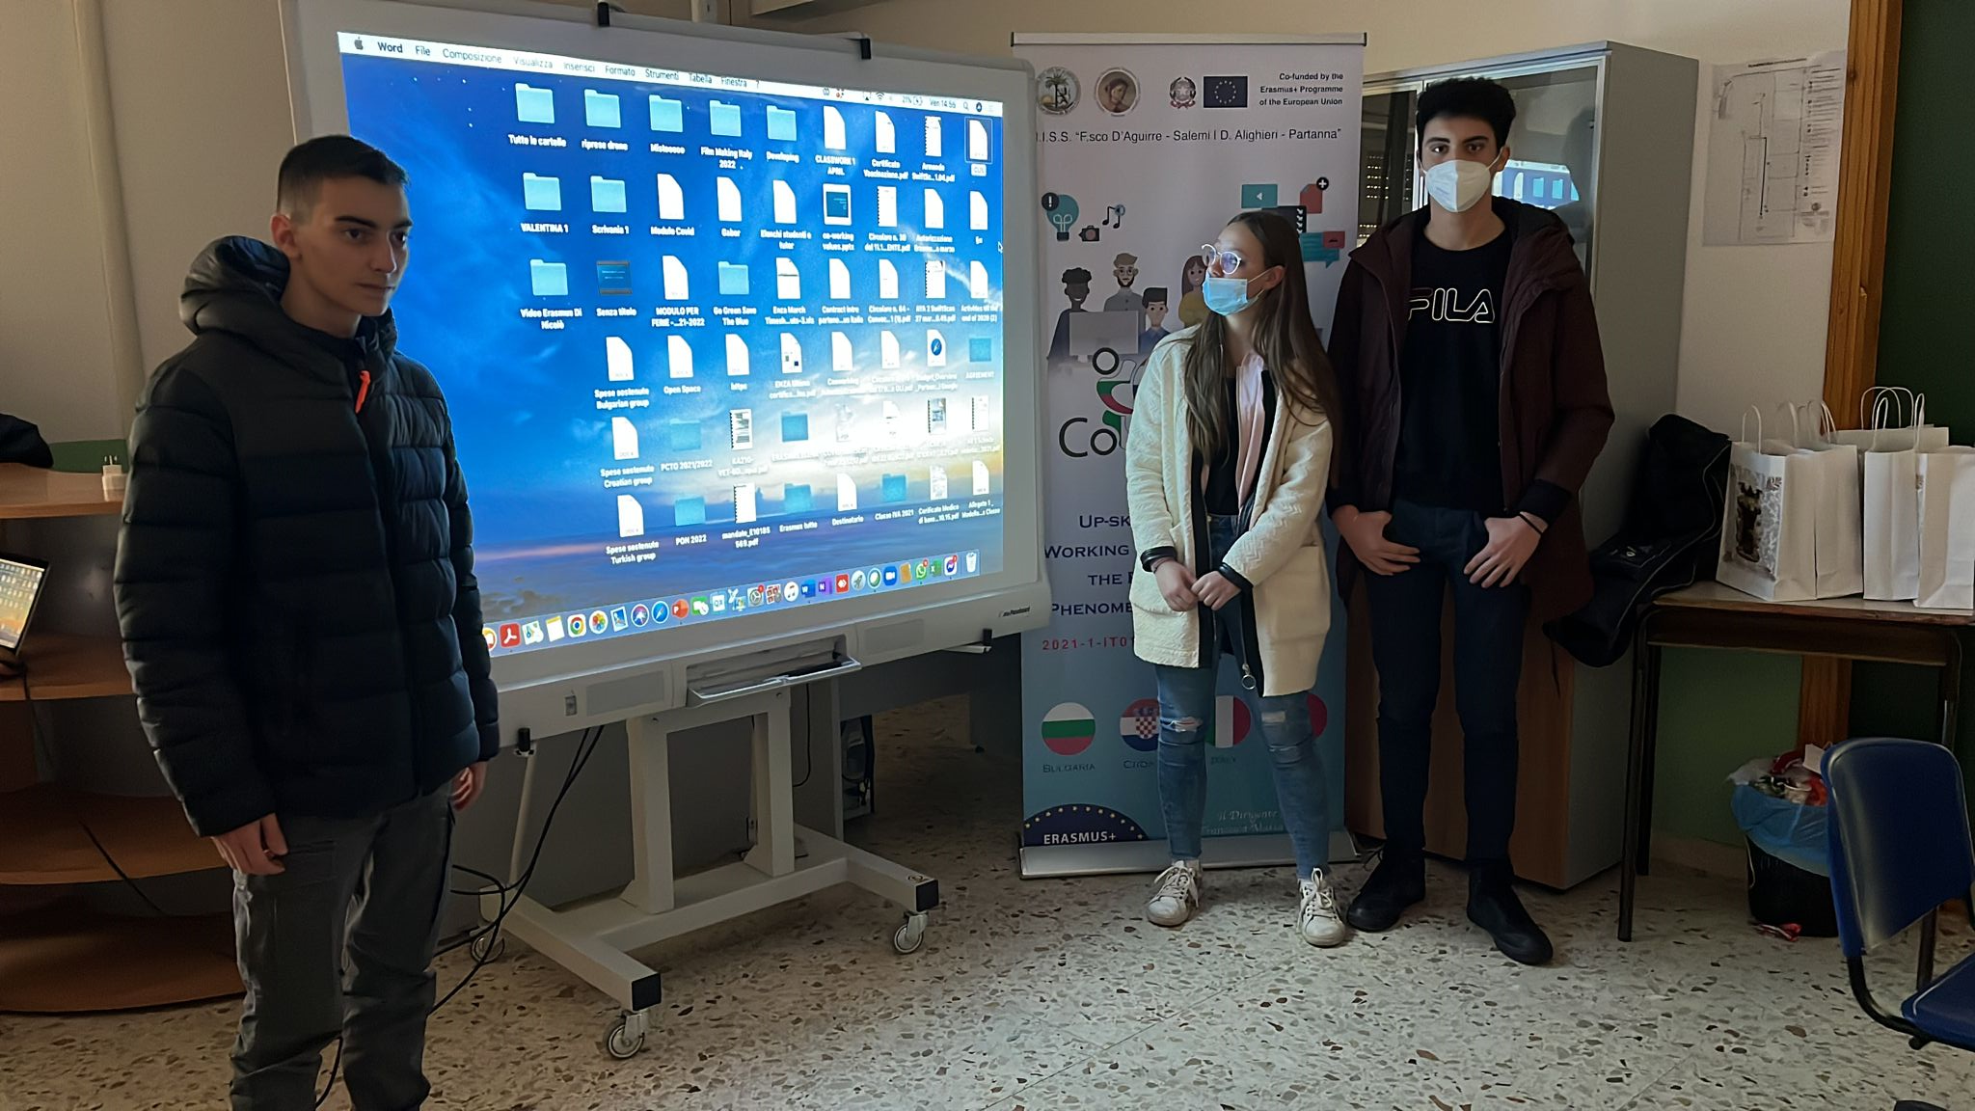
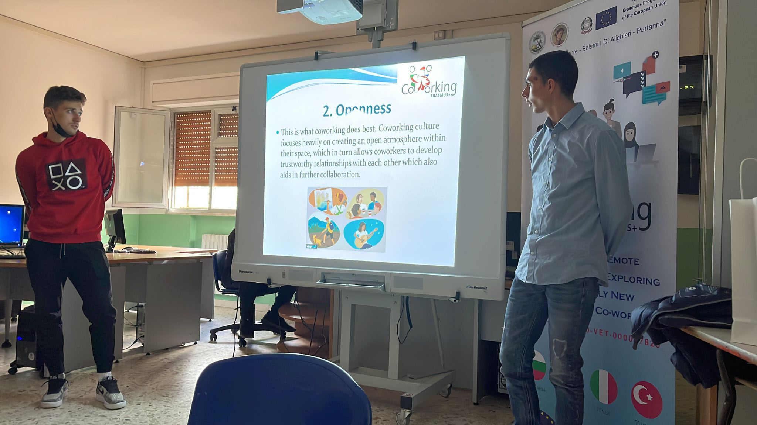
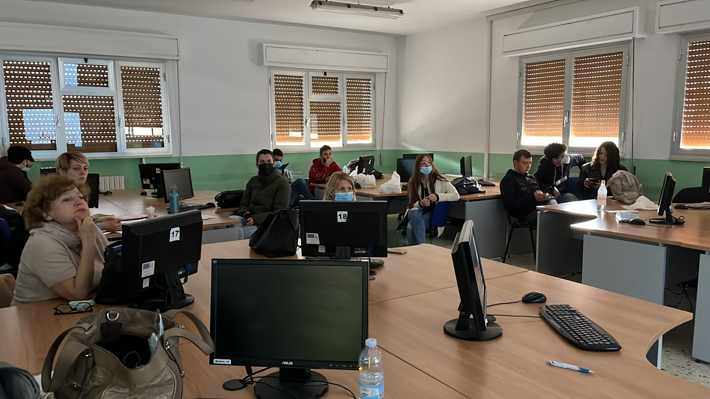
Teachers/Students Exchange ”The phenomenon of Co-working – Good practices”,
KA210-VET – Small-scale partnerships in vocational education and training
“Up-skilling in Remote Working through Exploring the Relatively New Phenomenon of Co-working” held in Salemi, Italy on the 30thMarch -3rd April, 2022

Slide 12
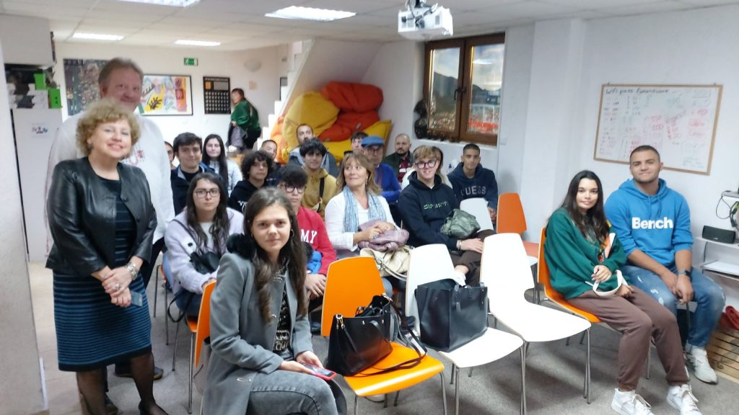
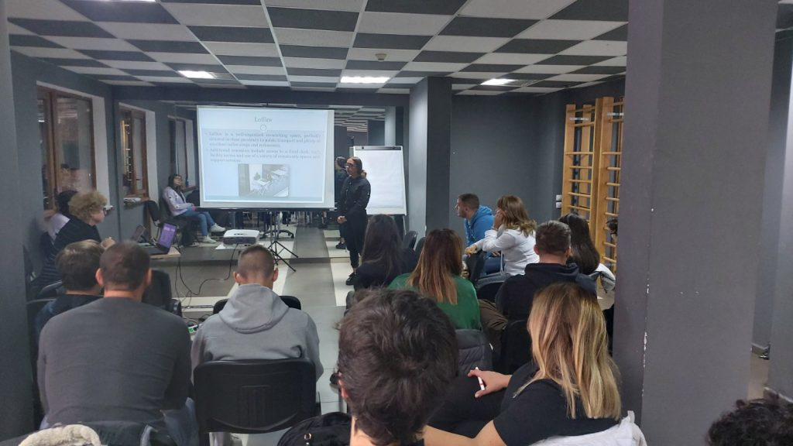
KA210-VET – Small-scale partnerships in vocational education and training
“Up-skilling in Remote Working through Exploring the Relatively New Phenomenon of Co-working”
Transnational Project Mobility 2
Bulgaria, 17th– 21st July, 2022

Slide 13
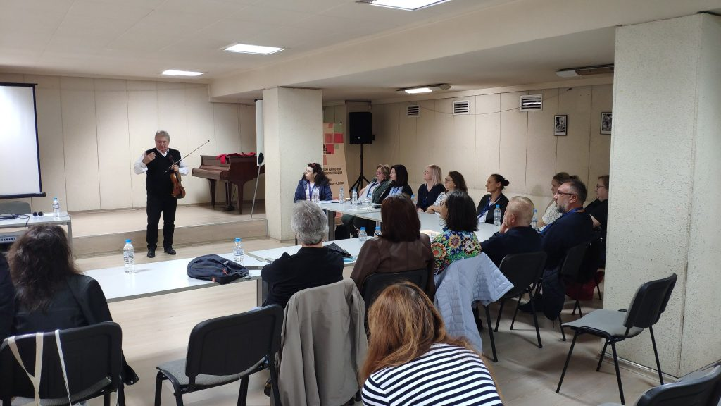
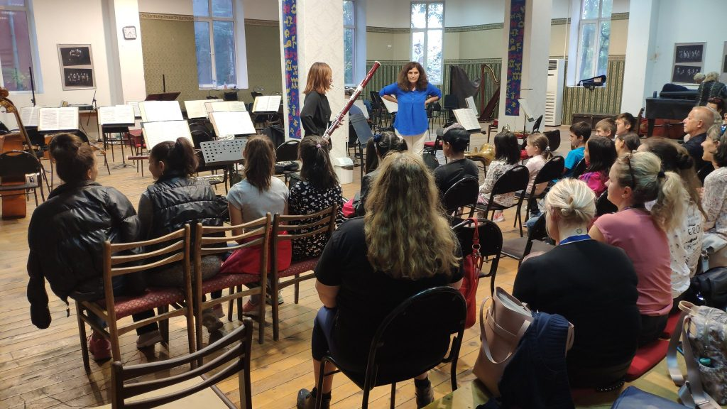
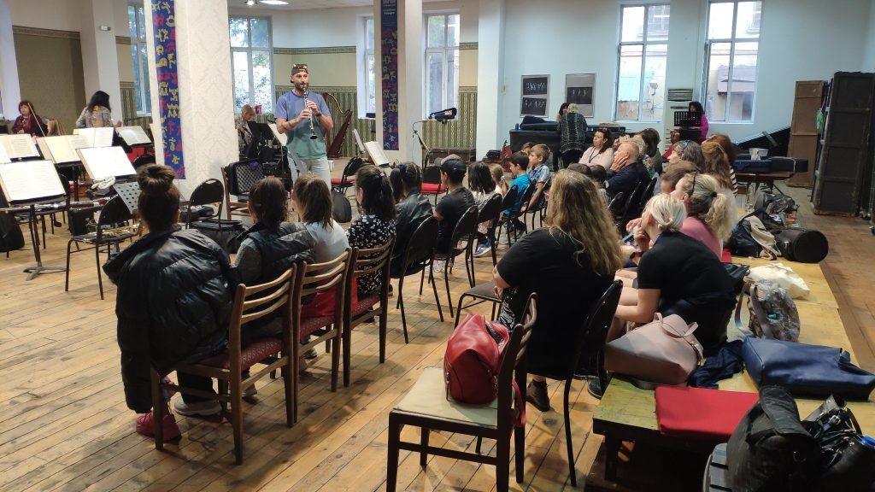
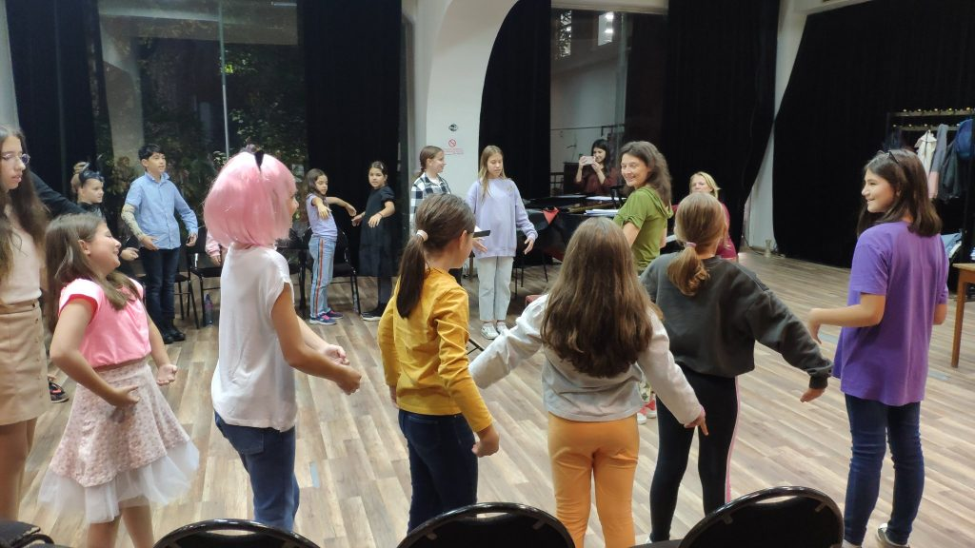
Rila-Pirin Enhancement Initiative is an associated partner in KA210-SCH – Small-scale partnerships in school education and training ’Facing Challenges and Finding Solutions in 21st Century Music Education for Young Learners’.
Three NGO members actively participated in:
Training Event “How to Make Cultural Institutions our Educational Partners” 29.10 – 2.11.2022 Plovdiv, Bulgaria

Slide 14
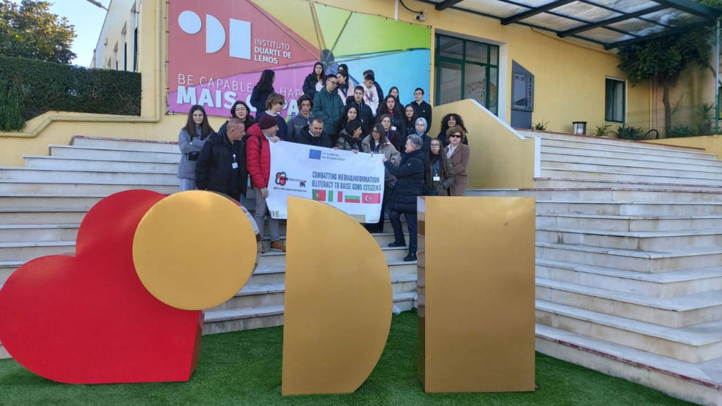
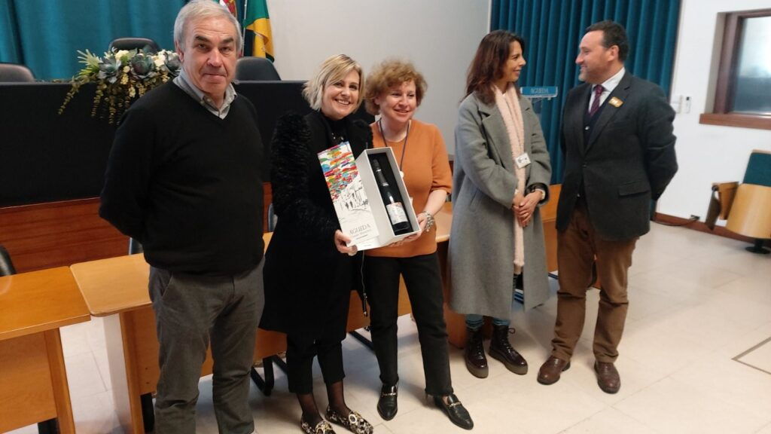
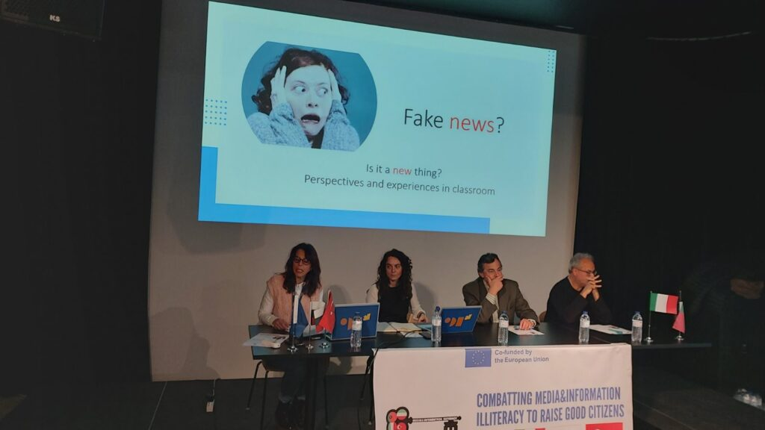
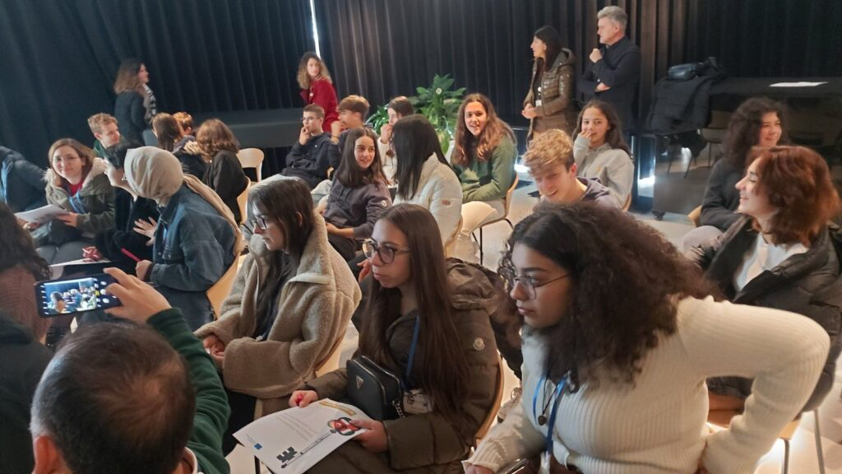
School Festival KA210-SCH – Small-scale partnerships in school education and training ’Combatting Media&Information Illiteracy to Raise Good Citizens’ Portugal, February, 2022

Slide 15
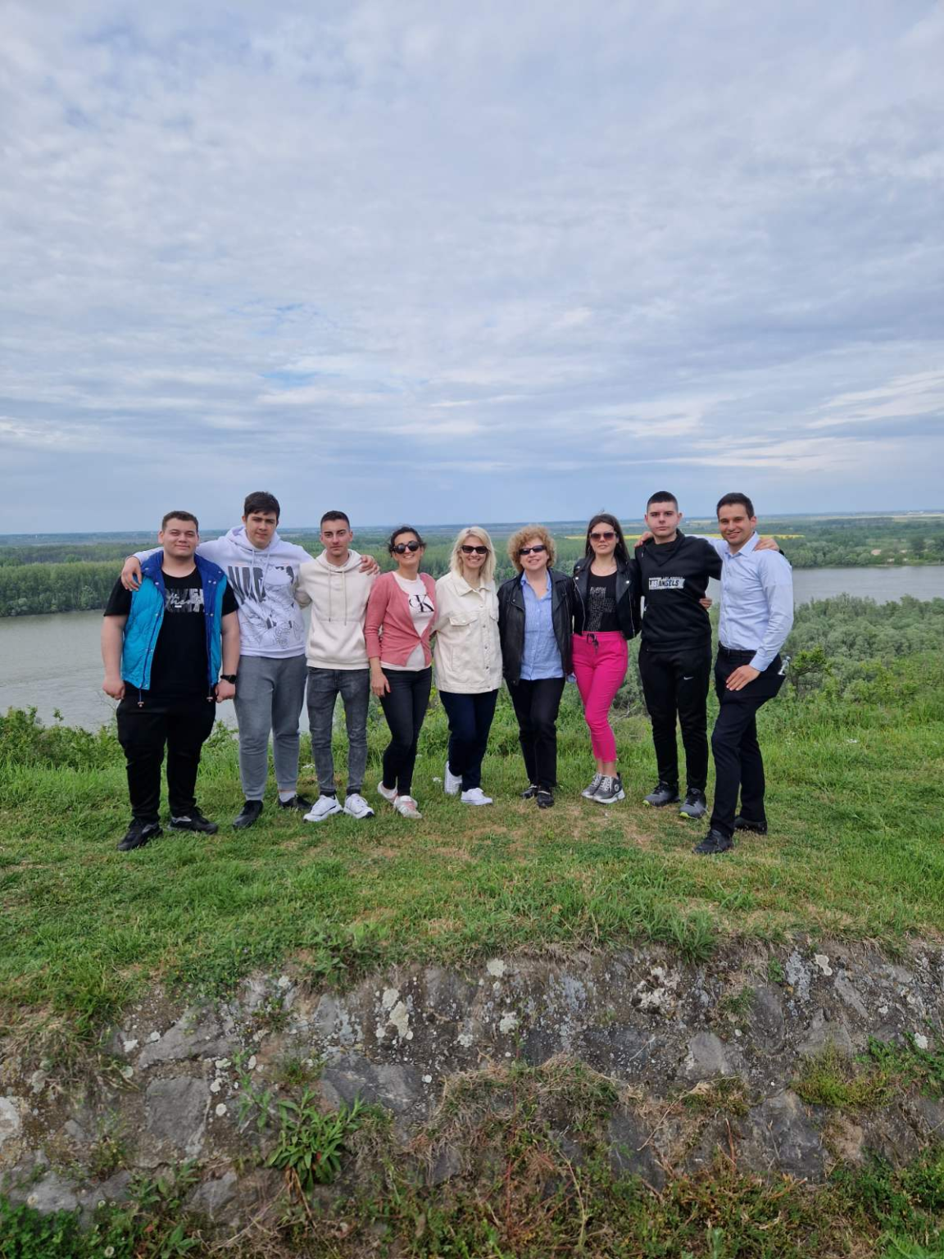
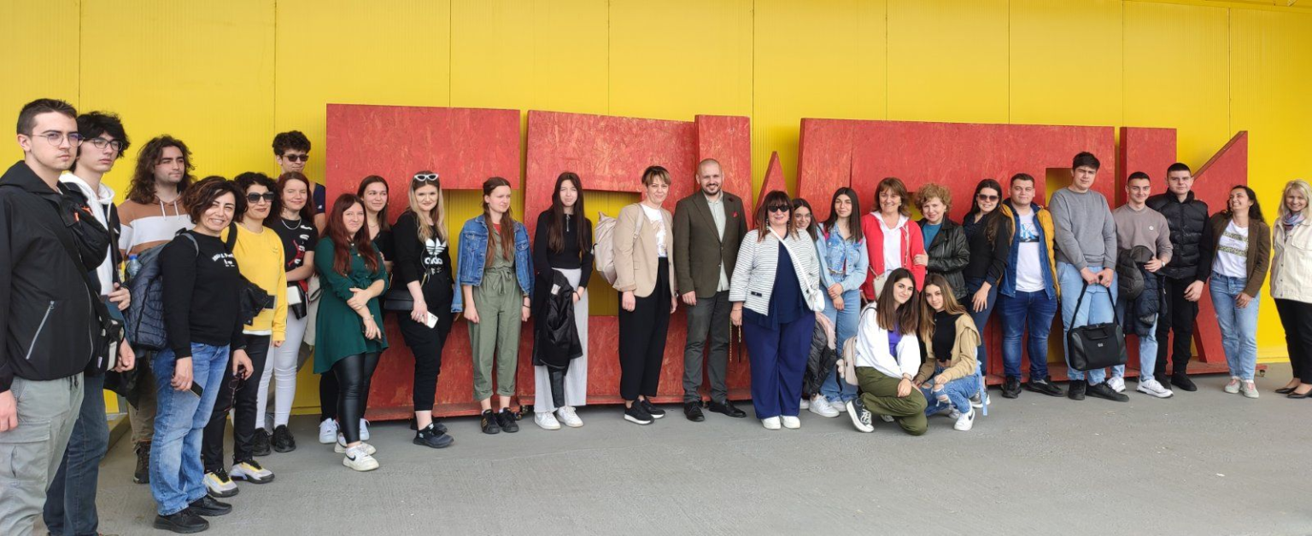
KA210-VET – Small-scale partnerships in vocational education and training
“Up-skilling in Remote Working through Exploring the Relatively New Phenomenon of Co-working”
Transnational Project Mobility 3
Field Day Event “Rural Co-working” May 2023, Croatia

Slide 16
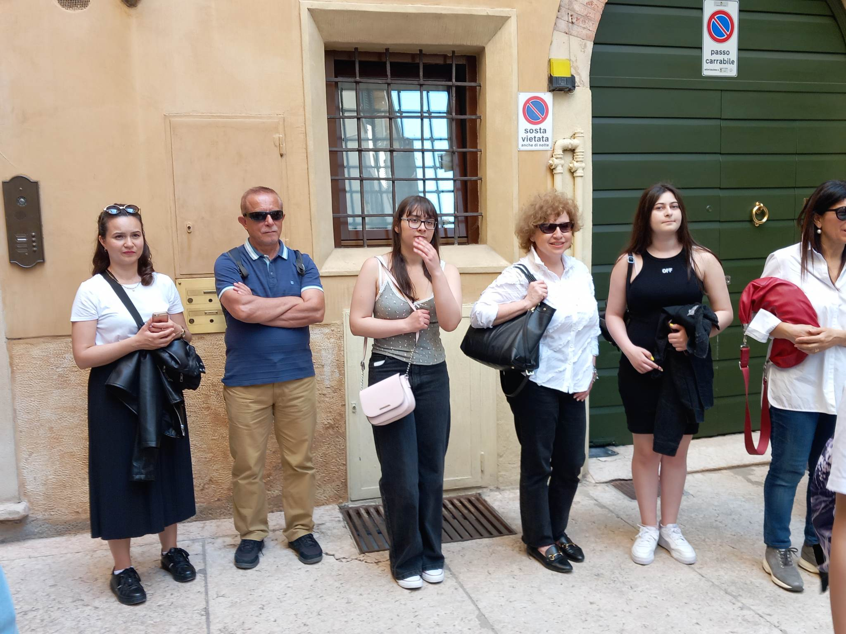
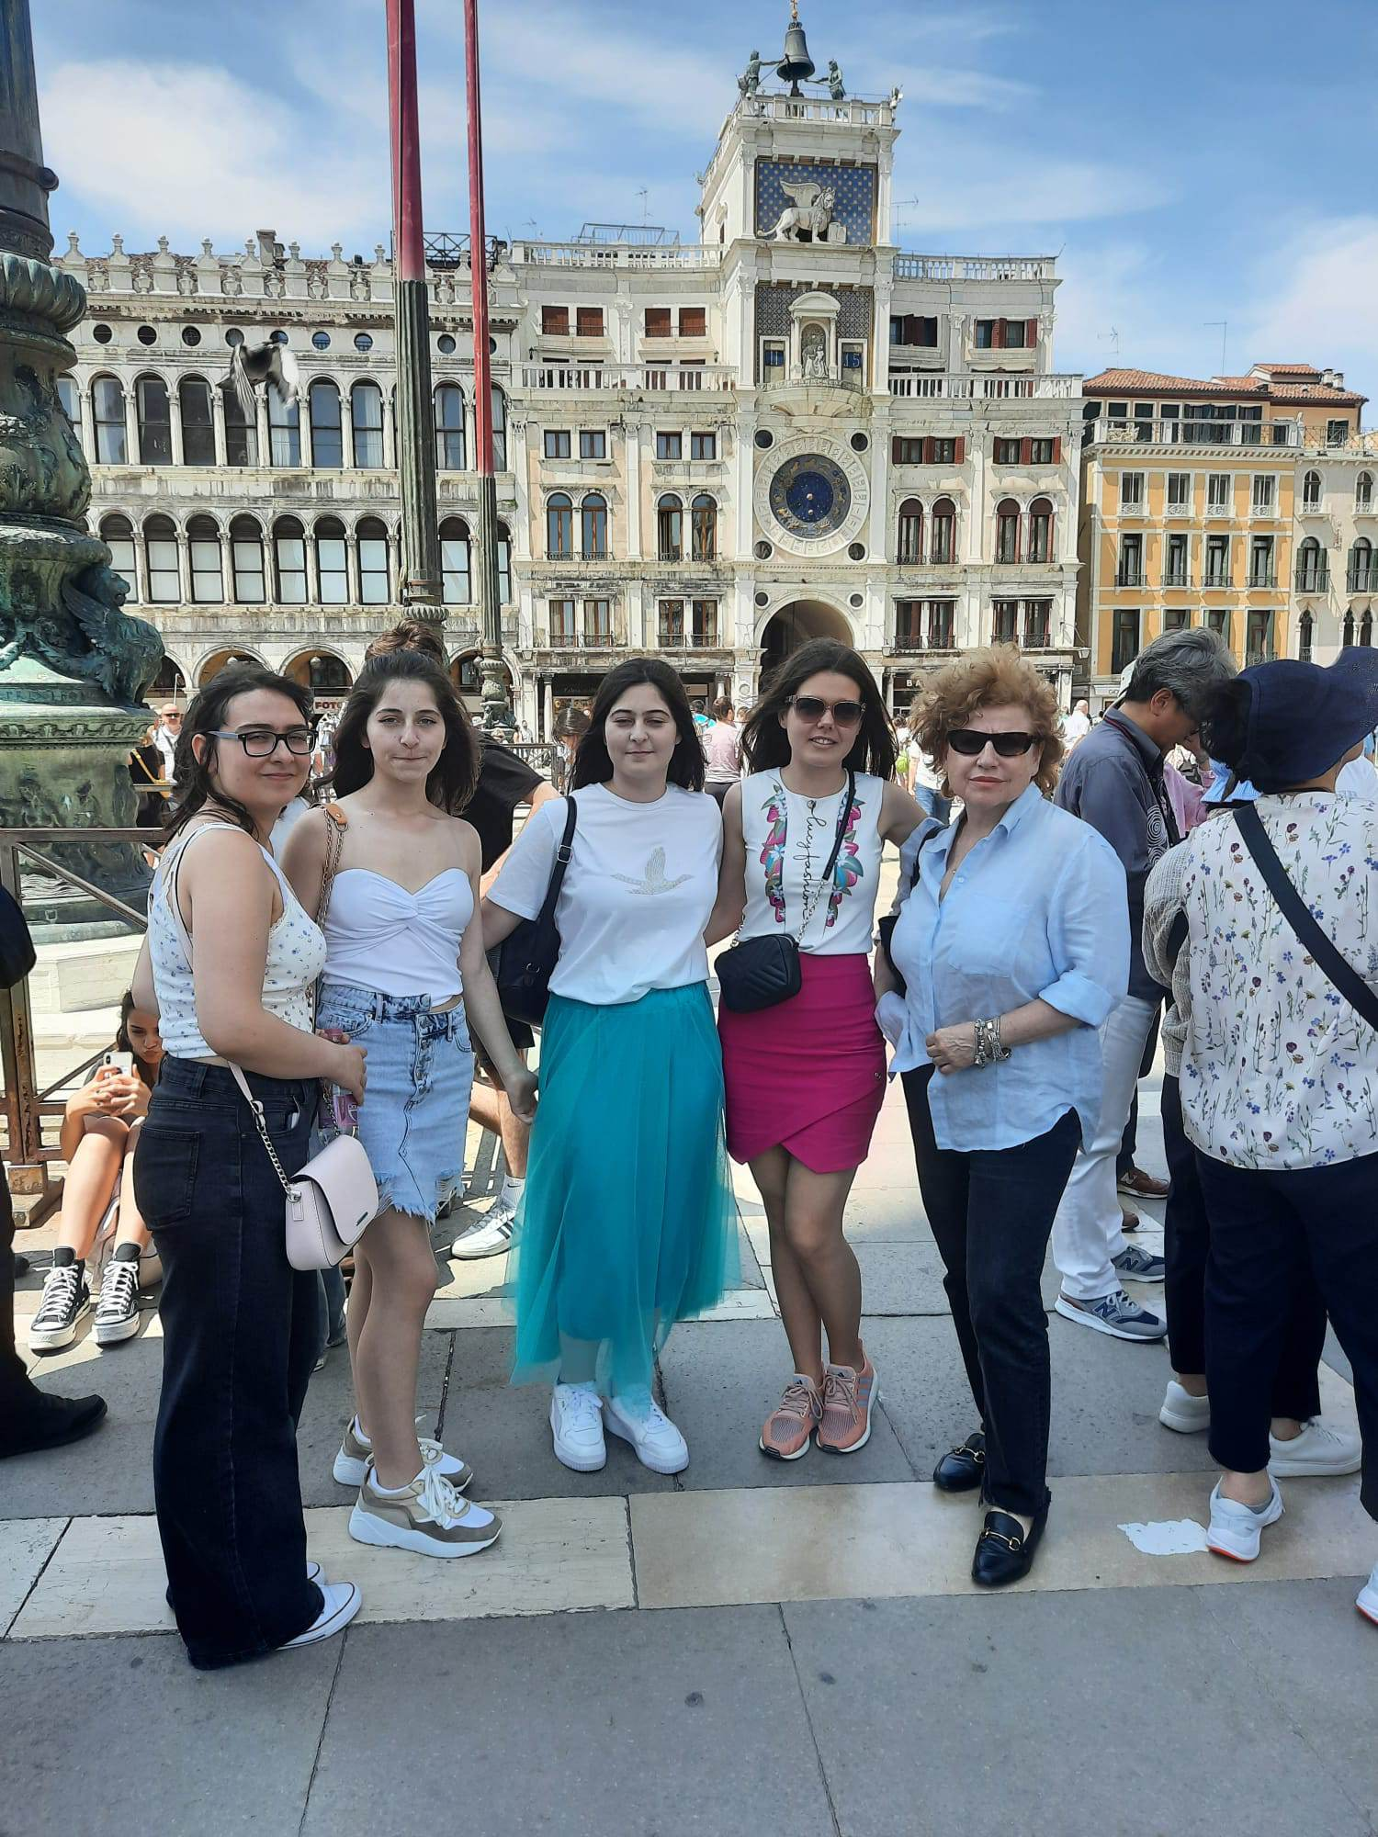
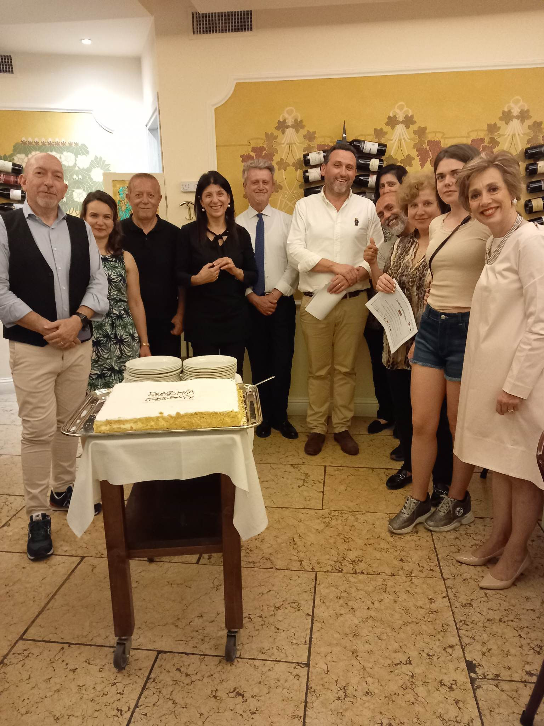
TRAINING EVENT ‘DIGITAL CITIZENSHIP’
KA210-SCH - Small-scale partnerships in school education and training
’Combatting Media&Information Illiteracy to Raise Good Citizens’
Under agreement N 2021-1-PT01-KA210-SCH-000031494
27th 31st May, 2023 - Verona, Italy

